Slide 1
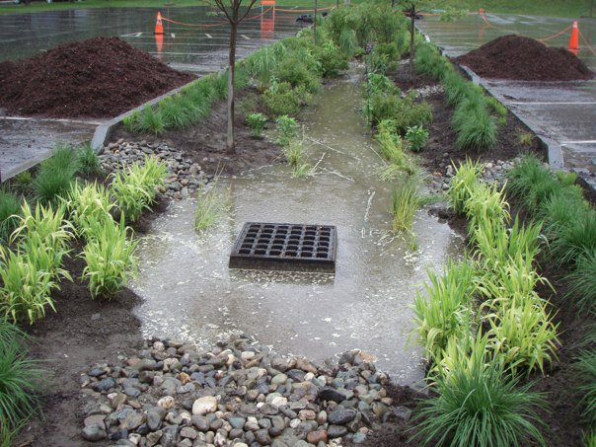
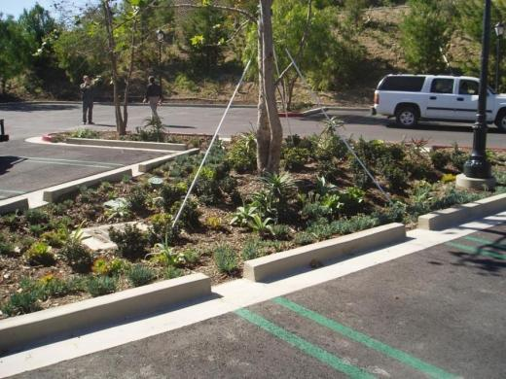
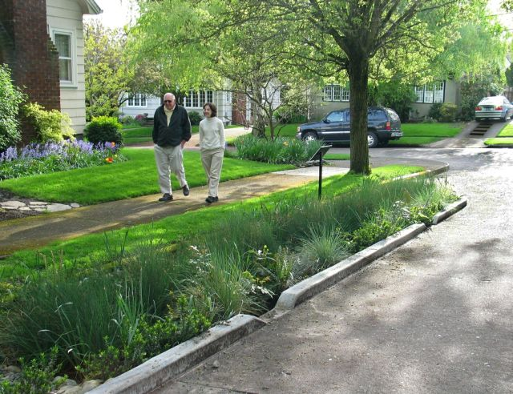
Multi-Agency Post-Construction Stormwater Standards Manual
Adopted 2015

Slide 2
Regulatory Requirements
Phase II Stormwater Permit
State Water Resources Control Board Order No. 2013-0001-DWQ “General Permit for Waste Discharge Requirements for Storm Water Discharges from Small Municipal Separate Storm Sewer Systems”
Phase II Permit requires Partners regulate development (Provision E.12)
Extension of similar requirements for larger communities subject to Phase I Stormwater Permits

Slide 3
Effective Date of Requirements
Develop post-construction standards within 2nd year of Phase II Permit (by 6/30/2015)
Condition new- and re-development projects to apply the post-construction standards within the 2nd year of the Phase II Permit
“Grandfathered Projects”
Discretionary permit projects that have been deemed complete before 6/30/2015
Public projects for which the governing body has approved design before 6/30/2015

Slide 4
Effective Date of Requirements
Standards must be applied to discretionary permit projects that
have not been deemed complete for processing by 6/30/2015
without vesting tentative maps that have not requested and received an extension of previously granted approvals
Standards must be applied public projects for which design is approved after 6/30/2015

Slide 5






Project Participants
Project Partners (Representatives)
City of Lathrop (Dameon Flores)
City of Lodi (Kathryn Garcia)
City of Manteca (Bret Swain)
City of Patterson (Sonia Delgado)
City of Tracy (Stephanie Reyna-Hiestand)
County of San Joaquin (Gerardo Dominguez)
Project Team
Gorman Lau, Larry Walker Associates
Sandy Mathews, Larry Walker Associates
Stakeholders
Notes:
RFP (Request for Proposals) process was done by the partners and a contract awarded to Larry Walker and Associates in January 2015 for a total of about $85,000. Each agency would pay about $14,000 - $15,000.

Slide 6
Manual Development Process
Kick-off meeting with Partners (02/05/15)
1st stakeholder meetings (02/26/15)
Drafted conceptual outline
Solicited input/comments
Draft Manual to Partners (04/07/15)
Draft Manual to stakeholders (04/20/15)
2nd stakeholder meetings (04/23/15)
Presented draft Manual
Received initial comments
Revised Draft Manual to Partners (05/19/15)

Slide 7
Manual Development Process
Revised Draft Manual to stakeholders (6/15/15)
Post-Construction Standards Presentation & Ordinance 1st Reading & Introduction to City Council (6/19/15)
Finalize Manual (06/30/15)
Ordinance 2nd Reading & Adoption (7/7/15)
City Council Manual Adoption by Resolution (09/15/15)
Requirements Effective as of July 1, 2015
Manual to be Incorporated and/or Referenced in the Updated City Standards coming to Council (Future)
Post-Construction Information to be incorporated into the Storm Drainage Master Plan prior to its Adoption
Notes:
ADOPTION OF MANUAL BY AGENCY:
Tracy - adopted in July
Manteca - adopted in August
Patterson – September 15th
Lodi - expected to adopt in November
Lathrop - unsure of status
San Joaquin County - did not need to formally adopt, but currently being implemented by Public Works Director as part of standards
Ordinance No. 777 (Urban Stormwater Quality Management & Discharge Control) – Section 13.32 of the City’s Municipal Code Section.

Slide 8
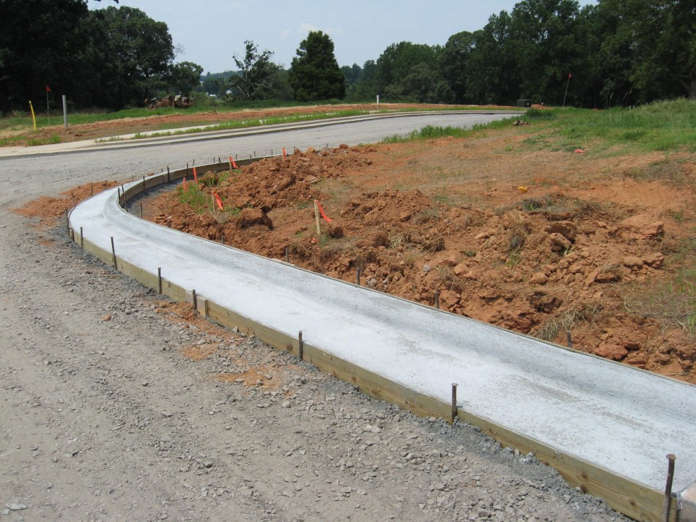
Traditional Stormwater Management
Development increases impervious surfaces
Precipitation becomes stormwater runoff and does not stay on-site
Storm drain system
Curb and gutter
Flood management
Discharge to receiving water
Source: Neill Grading and Construction

Slide 9
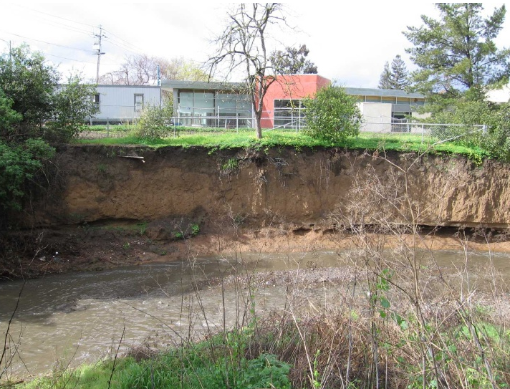
Environmental Impacts
Increased runoff (higher velocity) can result in channel erosion/degradation in the receiving water (hydromodification)
Increased concentration of pollutants (e.g., metals, solids, nutrients, bacteria, temperature)
Decreased groundwater recharge
Source: Berntsen, 2008
Source: Santa Clara Valley Urban Runoff Pollution Prevention Program

Slide 10
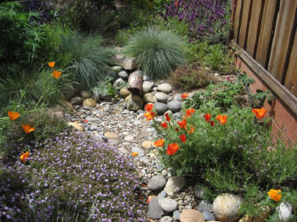
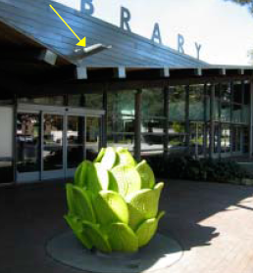
What is Low Impact Development (LID)?
An alternative method of land development
Seeks to mimic the natural hydrologic character of the site
Retains stormwater where it falls by promoting infiltration, evapotranspiration, and harvest/use
Source: Fall Creek Engineering/Santa Cruz Co
Source: City of San Jose

Slide 11
Benefits of LID
“Greener” form of development
Contributes to groundwater recharge
Improves water quality
Reduces peak flow volume and velocity
Increases aesthetics
Increases marketability of lots and projects
Source: USEPA 2014

Slide 12
Project Applicability
New Development and Redevelopment Projects (public and private) that create or replace impervious area
Small Projects (2,500-5,000 ft² impervious area)
Regulated Projects (≥5,000 ft² impervious area)
Hydromodification Projects (≥1 acre impervious area, with a net increase in impervious area)
Specific exclusions (e.g., routine maintenance)

Slide 13
Phase II Permit Requirements
Measures | Small Projects | Regulated Projects | Hydromodification Projects
Site Assessment | ⁽¹⁾ | X | X
Site Design | X | X | X
Source Control |  | X | X
Low Impact Development/Treatment |  | X | X
Baseline Hydromodification |  | X | X
Full Hydromodification* |  |  | X
Operations & Maintenance |  | X | X
⁽¹⁾ Not required, but recommended. ⁽²⁾ Full hydromodification is required by 6/30/2016

